Slide 1

Recurrent Neural Networks
with
Daniel L. Silver, Ph.D.
Andy McIntyre, Ph.D.
June 24, 2022
DEMO:
Aficionado
Slides based on originals by Yann LeCun

Slide 2
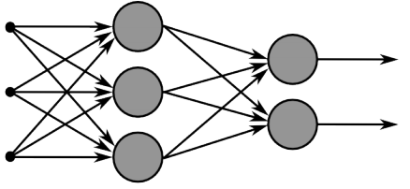
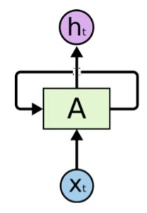
Recurrent Neural Networks
Multi-layer feed-forward NN: DAG
Just computes a fixed sequence of
non-linear learned transformations to convert an input pattern into an output pattern
Recurrent Neural Network: Digraph
Has cycles.
Cycle can act as a memory;
The hidden state of a recurrent net can carry along information about a “potentially” unbounded number of previous inputs.
They can model sequential data in a much more natural way.

Slide 3
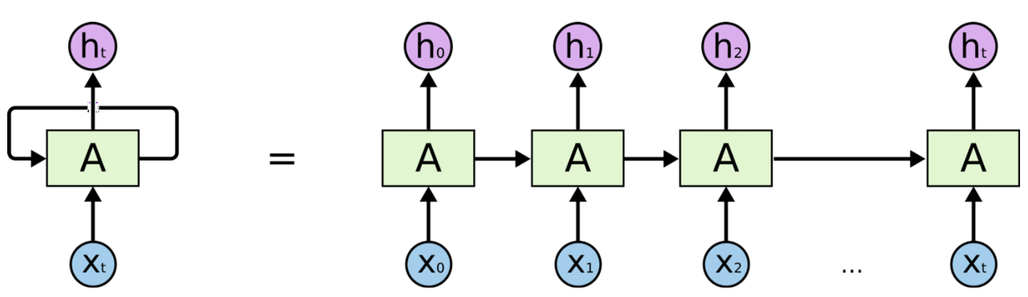
Simple Recurrent Neural Networks

Slide 4
Short-term memory in RNN
The context units remember the previous internal state.
Thus, the hidden units have the task of mapping both an external input and also the previous internal state to some desired output.
An RNN can predict the next item in a sequence from the current and preceding input.

Slide 5
RNN - great for learning a song ..

Slide 6
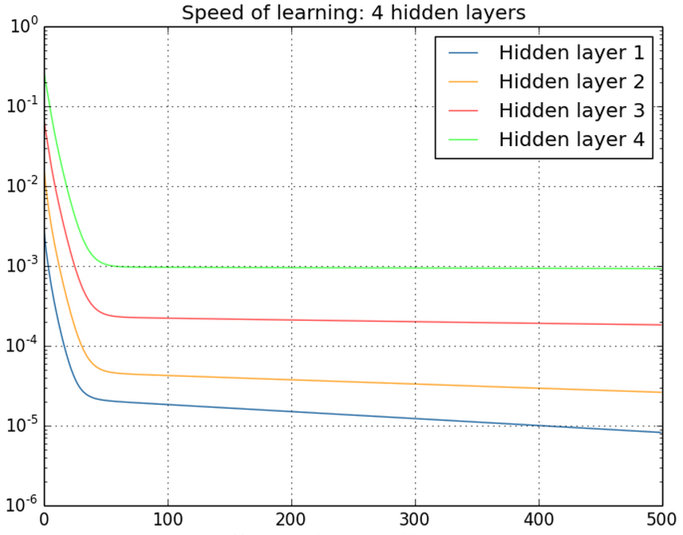
Vanishing/exploding gradients
Gradient can become very small or very large quickly, and the locality assumption of gradient descent breaks down (Vanishing gradient) [Bengio et al 1994]
Vanishing gradients are quite prevalent and a serious issue.
A real example
Training a feed-forward network
y-axis: sum of the gradient norms
Earlier layers have exponentially
smaller sum of gradient norms
This will make training earlier
layers much slower.

Slide 7
Vanishing/exploding gradients
In an RNN trained on long sequences (e.g. 100 time steps) the gradients can easily explode or vanish.
So RNNs have difficulty dealing with long-range dependencies.
Many methods proposed for reduce the effect of vanishing gradients; although it is still a problem
Abandon stochastic gradient descent in favor of a much more sophisticated Hessian-Free (HF) optimization
Add fancier modules that are robust to handling long memory; e.g. Long Short Term Memory (LSTM)
One trick to handle the exploding-gradients:
Clip gradients with bigger sizes

Slide 8
Long Short Term Memory (LSTM)
Hochreiter & Schmidhuber (1997) solved the problem of getting an RNN to remember things for a long time (like hundreds of time steps).
Key idea is that information from the distant past can be retained if important to model
They designed a memory cell using logistic and linear units with multiplicative interactions
Information gets into the cell whenever its “write” gate is on.
The information stays in the cell so long as its “keep” gate is on.
Information can be read from the cell by turning on its “read” gate.

Slide 9
Long Short Term Memory (LSTM)
Cell state vector provides
the memory of values from prior time steps

Slide 10
TUTORIAL 9
Develop and train a LSTM network using Keras and Tensorflow
tf.keras_rnn.ipynb
For much more (text generation, time series prediction):
https://www.tensorflow.org/tutorials/sequences/text_generation
https://machinelearningmastery.com/time-series-forecasting-long-short-term-memory-network-python/
Notes:
Rbm.py

Slide 11
References
Christopher Olah’s Blog
http://colah.github.io/
http://colah.github.io/posts/2015-08-Understanding-LSTMs/
Juergen Schmidhuber's tutorial
http://people.idsia.ch/~juergen/lstm/
Assaad Moawad's blog
https://medium.com/datathings/the-magic-of-lstm-neural-networks-6775e8b540cd

